Slide 1
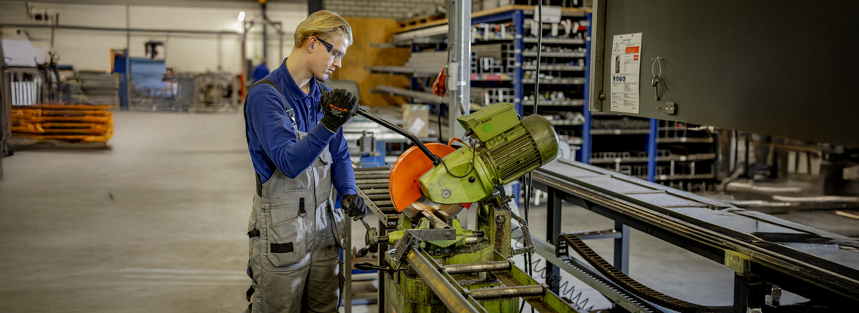
Toolbox Machine safety: Metal saw
Company name and date

Slide 2

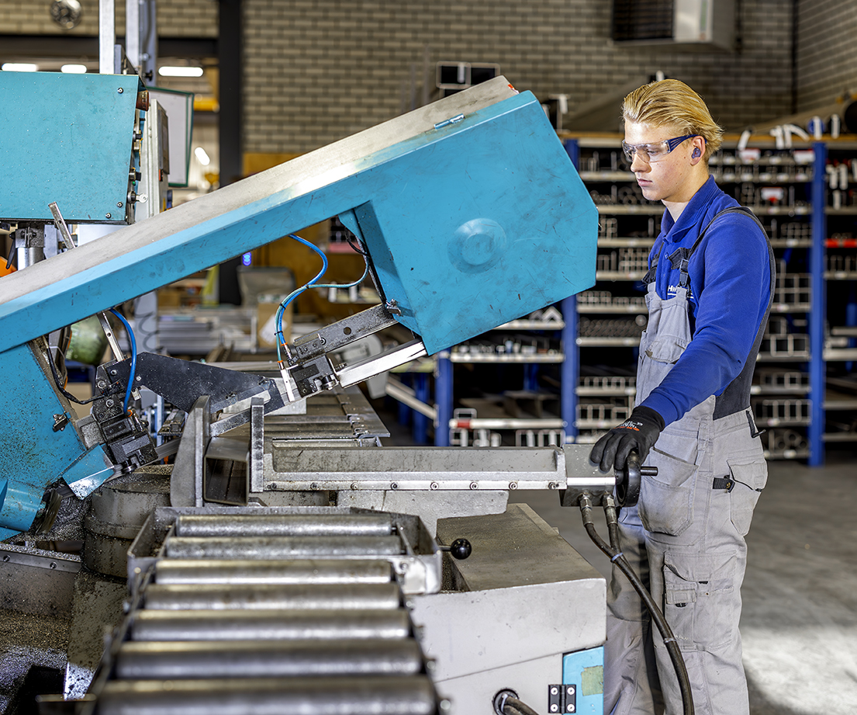
Contents
Safe and healthy working practices | Machine safety: Metal saw
Why machine safety?
Top 3 accidents
Safe machine
What can you do yourself?

Slide 3
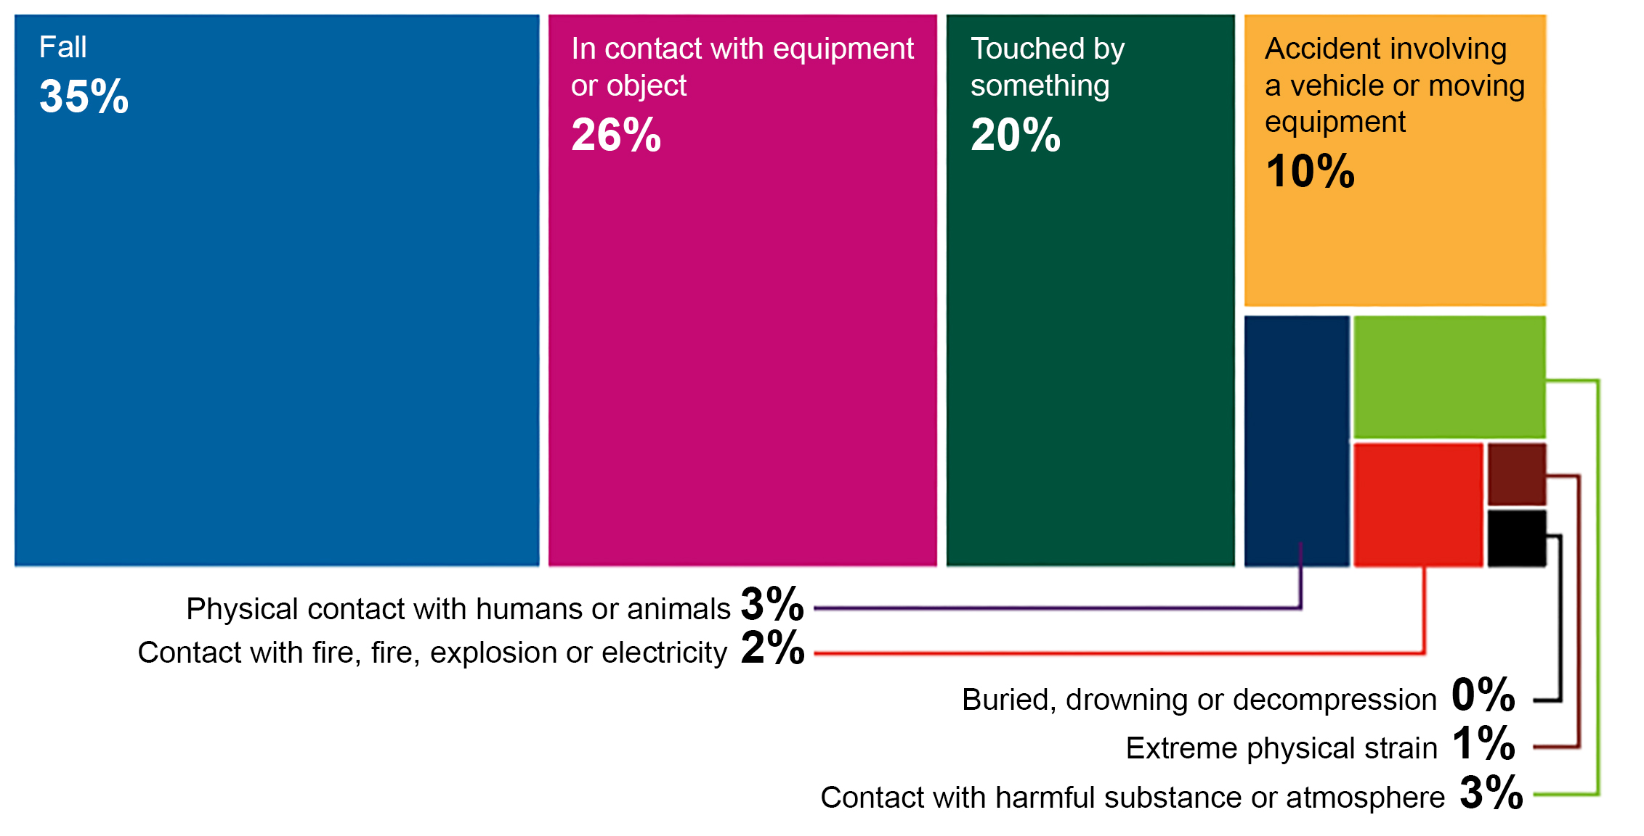
Safe and healthy working practices | Machine safety: Metal saw
Why machine safety?
Accident investigations completed in 2023, broken down by accident type.
Large proportion of the number of reported occupational accidents.
Contact with work equipment or object 26%.
Source: Work Accident Monitor 2023 – Dutch Labour Inspectorate
Notes:
https://www.nlarbeidsinspectie.nl/publicaties/rapporten/2024/08/26/monitor-arbeidsongevallen-2023
The accident type "Contact with work equipment or object" is common in the Industrial sector (42% of accidents in that sector). The majority of accidents involve accidents in which the victim came into contact with moving parts of a machine (69%).

Slide 4
Guard missing.
Safe and healthy working practices | Machine safety: Metal saw
Why machine safety?
Cause of contact with moving parts:
Guard missing, but insufficiently effective.
Guard removed.
Incorrect operation.

Slide 5
Clothing/hair/jewellery and gloves get caught in rotating parts.
Safe and healthy working practices | Machine safety: Metal saw
Cause of accidents involving metal saws
Failure to clamp the product securely.
Serious and permanent injury:
Amputation and fractures of fingers, hands, arms or internal injuries. Fractures and large cuts to other parts of the body resulting in loss of function.

Slide 6
Check that the machine is stable.
Safe and healthy working practices | Machine safety: Metal saw
Safe machine
Check that the saw blade is shielded.
Check that the clamping mechanism is working.
Check whether the power cables, plugs and connections are undamaged.
Check that the emergency stop is readily accessible during use.
Check that measures have been taken to prevent flying chips and liquid.

Slide 7

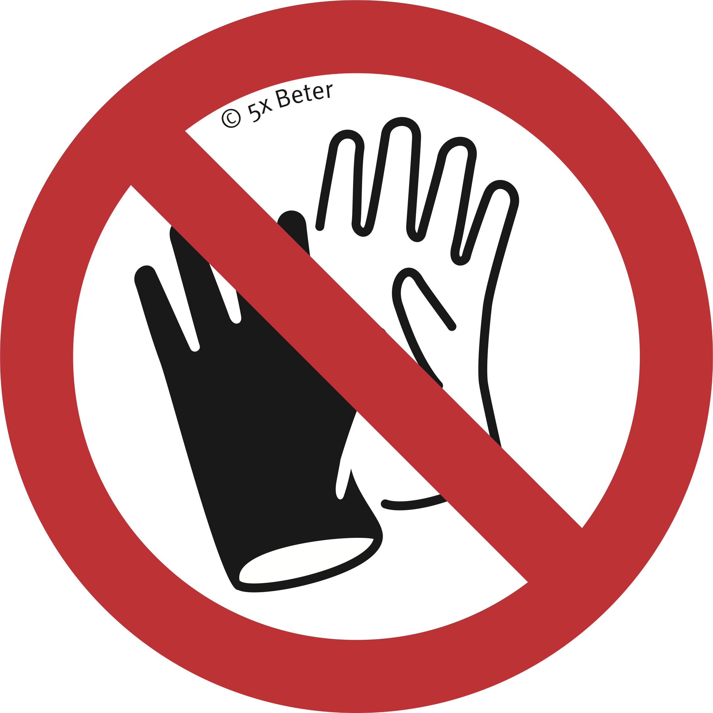
Safe and healthy working practices | Machine safety: Metal saw
What can you do yourself?
Prevent clothing, jewellery and hair from being caught in the sawing machine.
Never bypass the safety devices.
If safety devices are missing or have been bypassed, discuss this with your manager.
Test the emergency stop.
Wear hearing protection at noise levels of 80 dB and above.
Do not start work if you have any doubts about the safety of the machine; discuss this with your manager.
Ensure the stability of the machine and the workpiece by using roller conveyors or roller stands, for example.
It is recommended to wear safety goggles.

Slide 8

Safe and healthy working practices | Machine safety: Metal saw
Questions?
info@5xbeter.nl | www.5xbeter.nl

Slide 9
Safe and healthy working practices | Machine safety: Metal saw
Need help?
Discuss it with your manager or contact the health and safety officer.
Consult an Improvement Coach from 5xbeter: www.5xbeter.nl
Or call the FREE Improvement Line: 0800 – 55 55 005
info@5xbeter.nl | www.5xbeter.nl

